Slide 1


Data Science Bootcamp
Baigal & Flaude
Notes:
12-03 12-21
12-23 12-36
12-36 12

Slide 2


Prédire la production & la consommation d’énergie

Slide 3
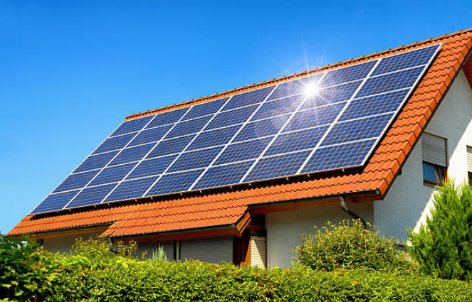
Objectif :
Construire un modèle de Machine Learning qui prédit la production et la consommation triennale d’énergie d’une installation solaire résidentielle.

Slide 4

Project idea
Future of energy:
The world is in a transition to new kinds of energy:
Blockchain enabled software platform for trading renewable energy and environmental commodities.
“Energy independence is new independence.”
The peer-to-peer nature of blockchain could provide a particularly useful answer to the existing problems we see within energy networks around the world.
Image source

Slide 5
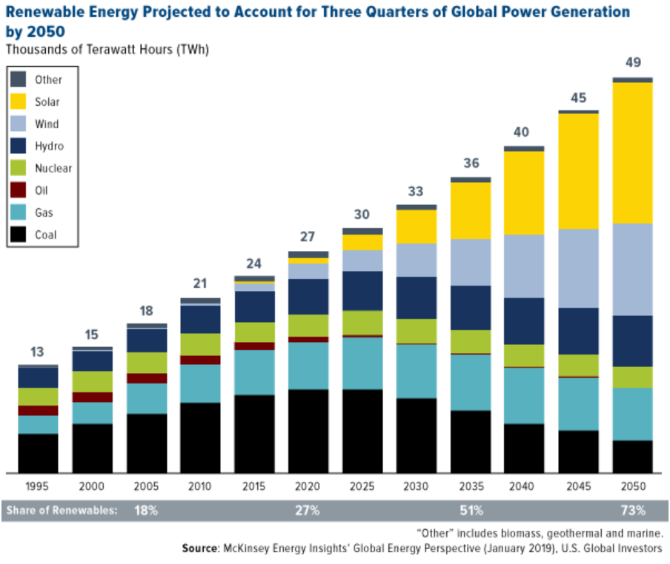
Contexte :
Transition énergétique.

Slide 6
Méthodologie adoptée:
Recherche les données
EDA
Modélisation
Feature selection
Résultats
Conclusions

Slide 7
Recherche les données

Slide 8

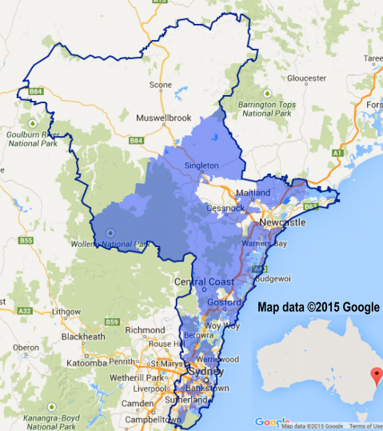

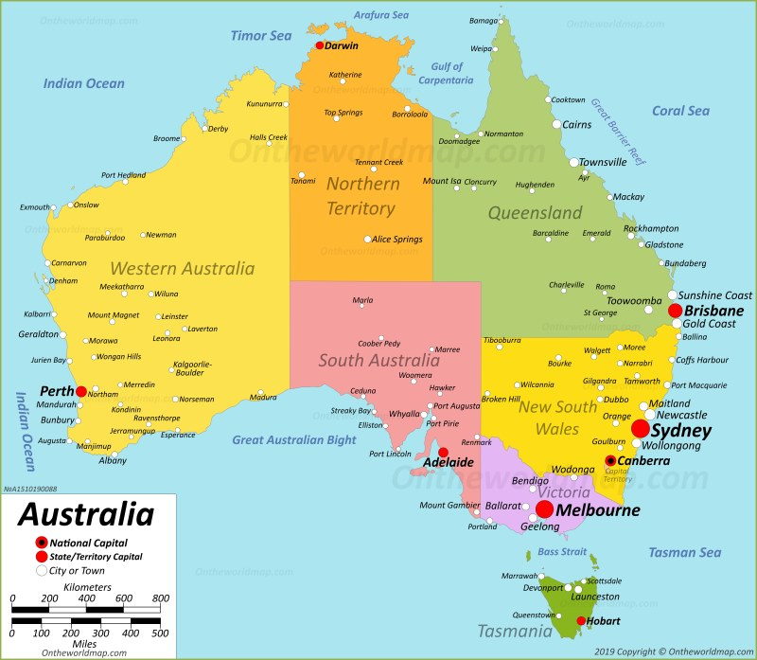
Les données
Les données de ce projet proviennent de l’API de Ausgrid et concernent concernent 300 foyers équipés de systèmes solaires sur le toit.

Slide 9
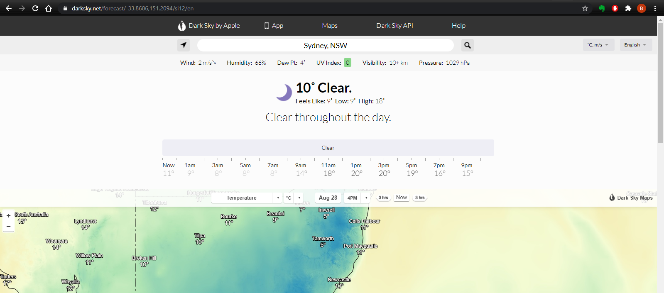
Pour les données météorologiques
Nous avons utilisé les informations météorologiques de DarkSky.net. Nous avons fait du web-scraping pour obtenir 3 ans de données météo, température, indice UV, neige.

Slide 10
Data overview
Location | Australia, East coast
Date | 2010-2013
Number of observations | 300 household
Repeat | Every 30 mins
Data for energy consumption +
Features | Temperature,, UV Index, Cloud Cover, Rain chance, Snow chance, Dew point, Pressure, Wind speed, Wind Gust, Wind Bearing, Visibility
 | Humidity
 | UV Index
Data for energy consumption
Data for energy generation

Slide 11
EDA

Slide 12
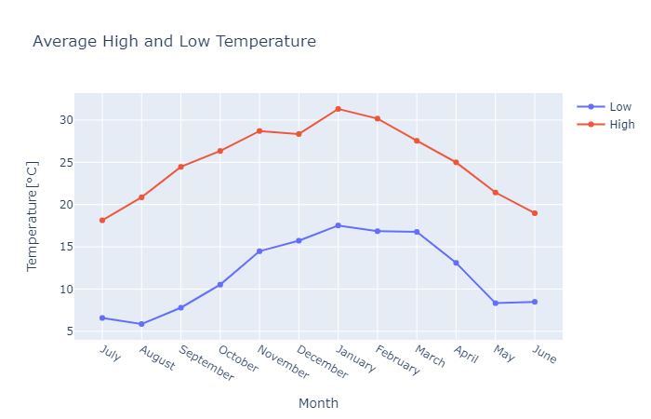
Average High and Low Temperature

Slide 13
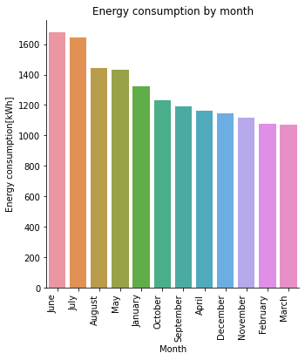
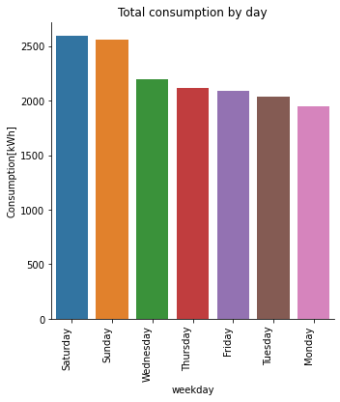
Energy consumption by month, by week

Slide 14
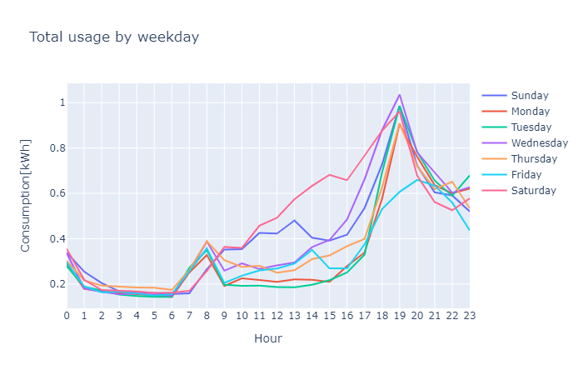
Energy consumption by week and weekend

Slide 15
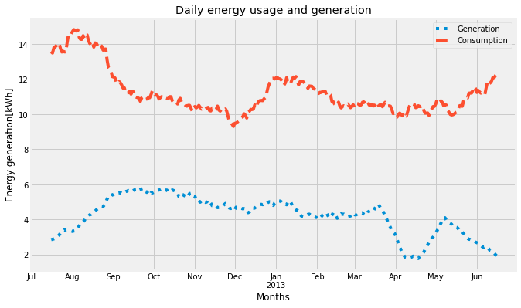
Daily energy generation and consumption

Slide 16
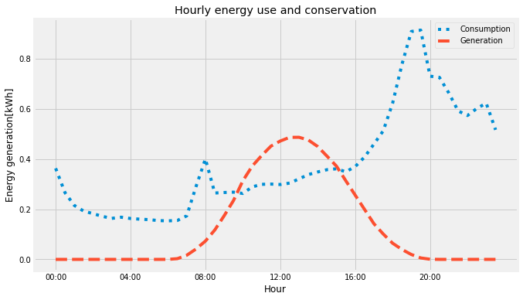
Energy generation and consumption hourly

Slide 17
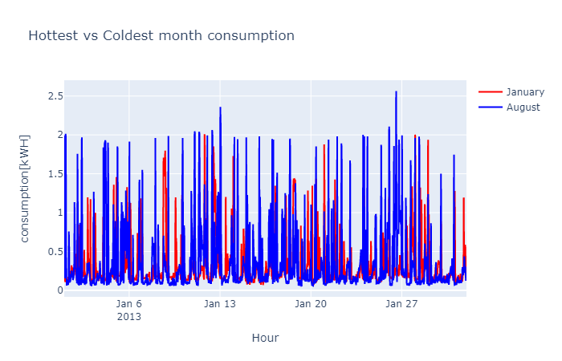
Hottest vs Coldest month consumption

Slide 18
Energy generation and features

Slide 19
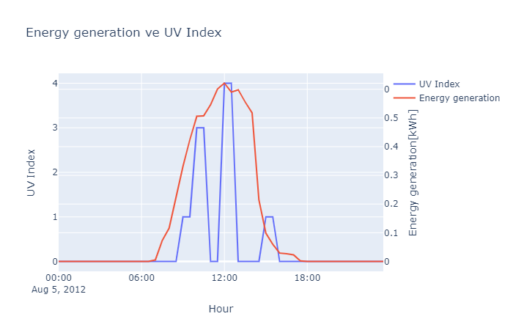
Energy generation vs UV Index

Slide 20
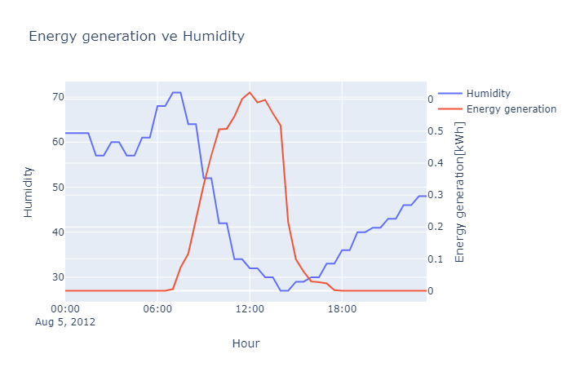
Energy generation vs Humidity

Slide 21
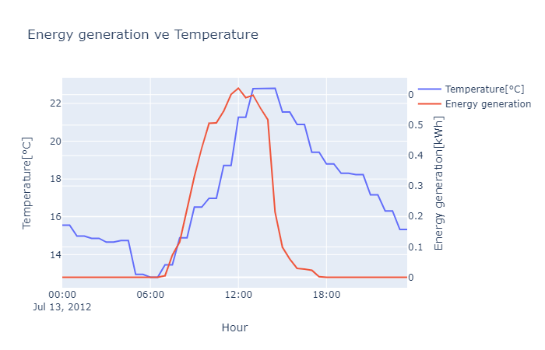
Energy generation vs Temperature

Slide 22
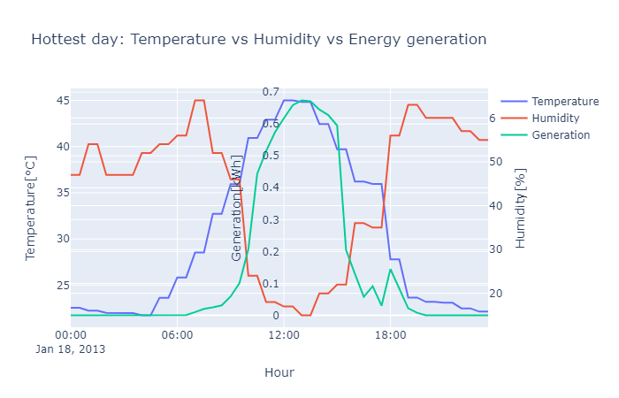
Temperature, humidity and generation

Slide 23
Modélisation sur la production d'énergie

Slide 24
Feature selection

Slide 25
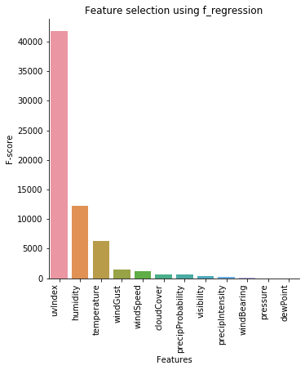
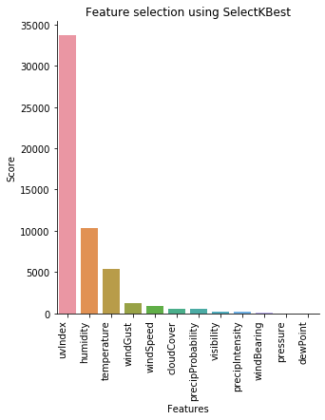
Feature selection
Nous avons utilisé 2 méthodes de sélection des features:
Most important feature (LR)
SelectKBest method

Slide 26
Modèles et Résultats
Model | Before Feature selection |  | After Feature selection
Score | R2 score | RMSE | R2 score | RMSE
Linear regression | 0.23 | 0.23 | 0.23 | 0.23
Random Forest | 0.23 | 0.23 | 0.23 | 0.23
XGBoost | 0.23 | 0.23 | 0.23 | 0.23

Slide 27

Modélisation sur la consommation d'énergie
source

Slide 28
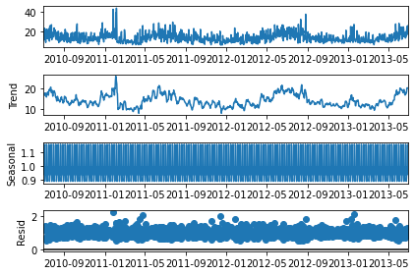
Forecasting Time series
Why time series is special?
Level: The baseline
Trend: Behavior of the series over time.
Seasonality: Repeating patterns or cycles of behavior over time.
Noise: Variability in the observations
Stationarity: A time series is stationary when the mean, variance, and autocorrelation are constant over time
ARIMA model

Slide 29
Forecasting using these models
ARIMA
SARIMAX
LSTM (deep learning)
Facebook’s Prophet

Slide 30
Modèles et Résultats
Modèle | RMSE[kWh]
ARIMA | 5.4
SARIMAX | 4.1
LSTM | 3.8
Prophet | 5.5

Slide 31
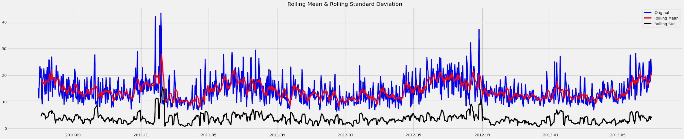
ARIMA model
Important parameters:
AR:p Auto-regressive aspect of the model, which incorporates past values.
Integrate:d Integrated part of the model. Effect the amount of differencing to apply to a time series
MA:q Moving average part of the model

Slide 32
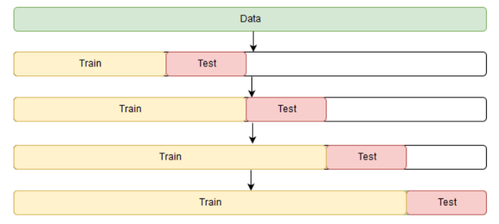
ARIMA model
Find best parameters: auto_arima (GridSeachCV in arima)
Window rolling technic

Slide 33
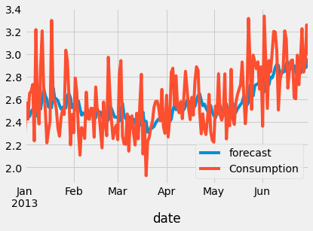
ARIMA modeling result
Model gets the trend and level. But not much accurate in terms of highest and lowest points.
Prediction vs actual consumption

Slide 34
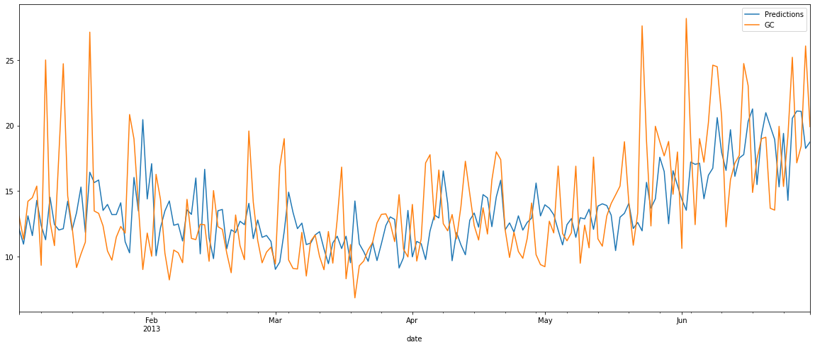
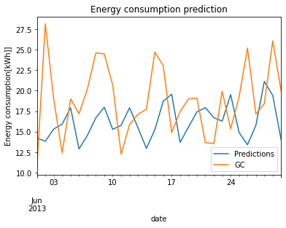
SARIMAX model
ARIMA model with SEASONALITY
Train set
Test set (prediction)

Slide 35
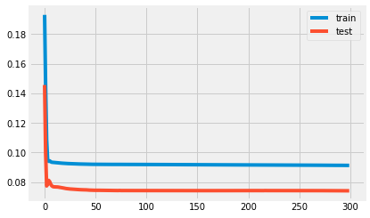
Naive LSTM model
Most simple LSTM model with 2 layers(input 100), 1 Dense layer (output 1), loss function:mae, optimizer:adam.
Loss in train, test set

Slide 36
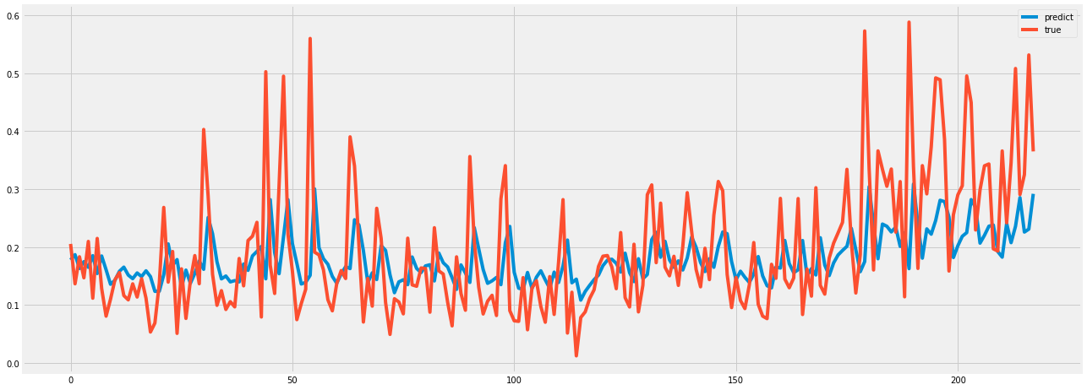
Naive LSTM model result
Result in test set

Slide 37
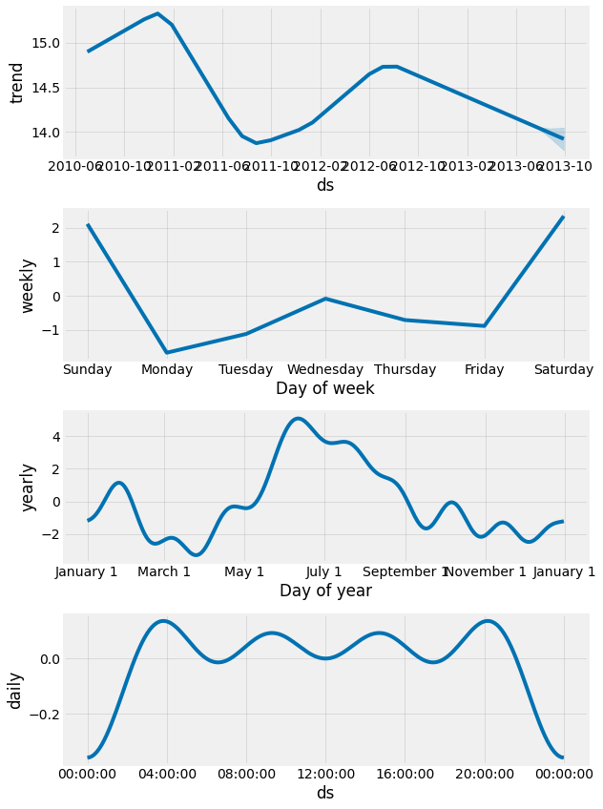
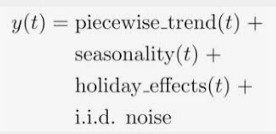
Facebook Prophet
Prophet uses models trend, seasonality and HOLIDAY effects, and irreducible error.
Prophet
Decomposition

Slide 38
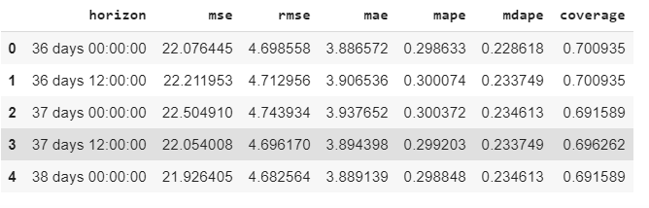
Facebook Prophet
We can see more detail in Prophet result!
Prophet result

Slide 39
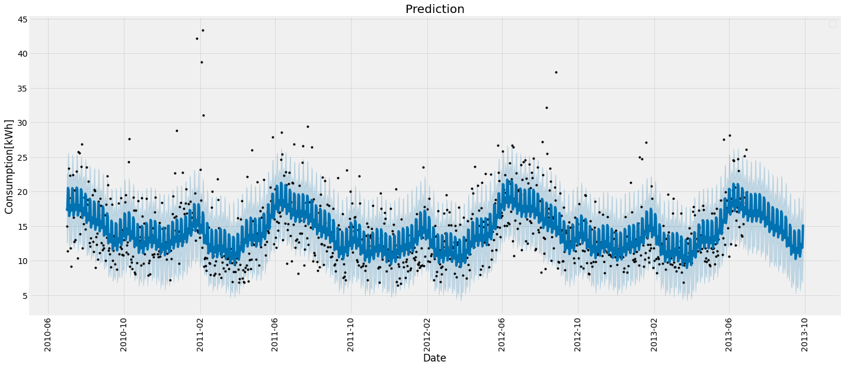
Facebook Prophet result
Prediction

Slide 40
Conclusion & Perspectives

Slide 41
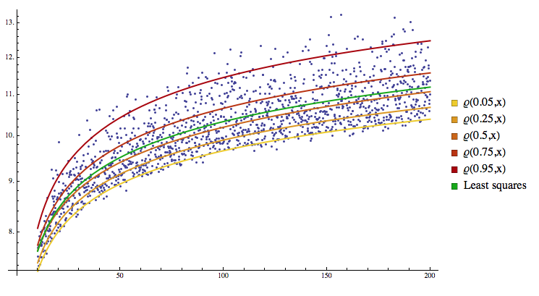
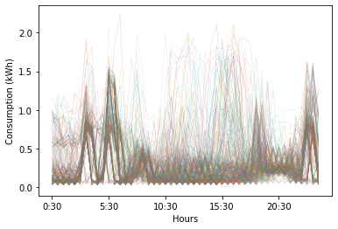
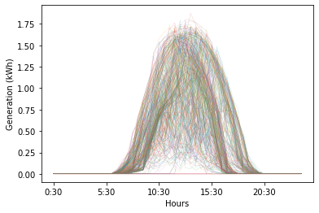
What we didn’t do:
Use quantile regression K-near neighbors method to find 300 household energy consumption and generation

Slide 42
Merci pour votre aimable attention !
Question(s) ?

Slide 43
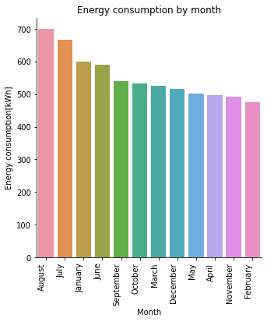
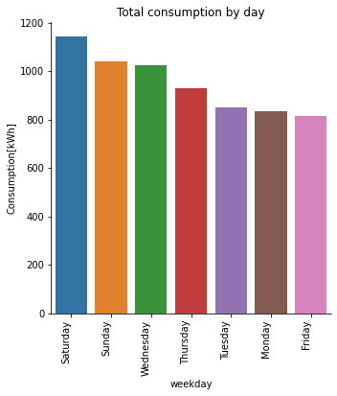
Energy consumption by month, by week
WRONG

Slide 44
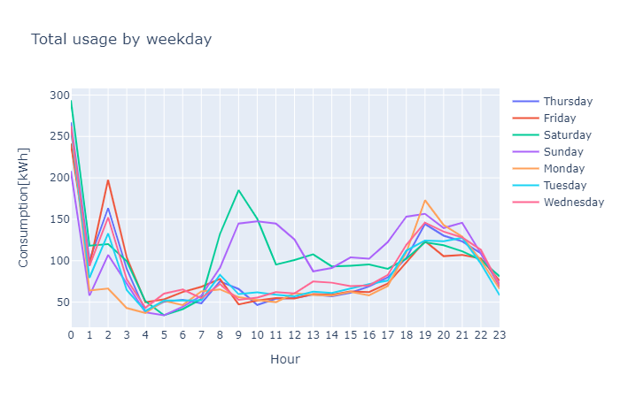
Energy consumption by week and weekend
WRONG

Slide 45
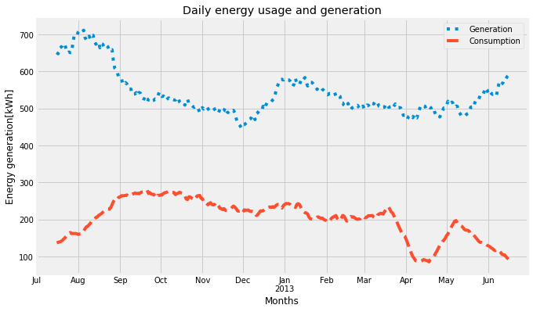
Daily energy generation and consumption

